Slide 1

Support Vector Machine
Franz Andersch & Niklas Münz

Slide 2
Structure
Introduction
How it works
Hard Margin
Soft Margin
Kernel Trick
Pros and Cons
Performance Evaluation
Current Status
What comes next?
Sources

Slide 3
1. Basic idea of Support Vector Machine
Especially effective in binary classification (also used for regression)
Find the hyperplane that separates classes with the maximum possible margin
Only the support vectors (datapoints closest to hyperplane) have direct influence on the position of the hyperplane

Slide 4
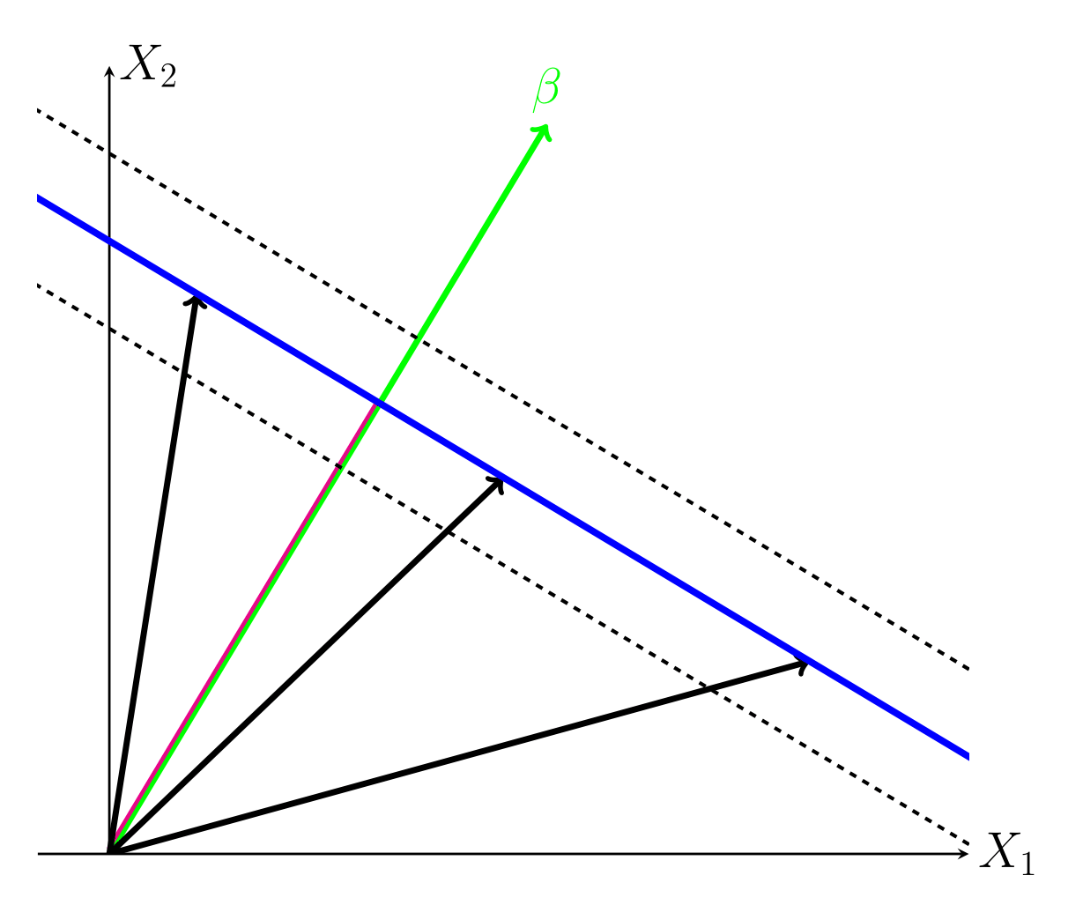
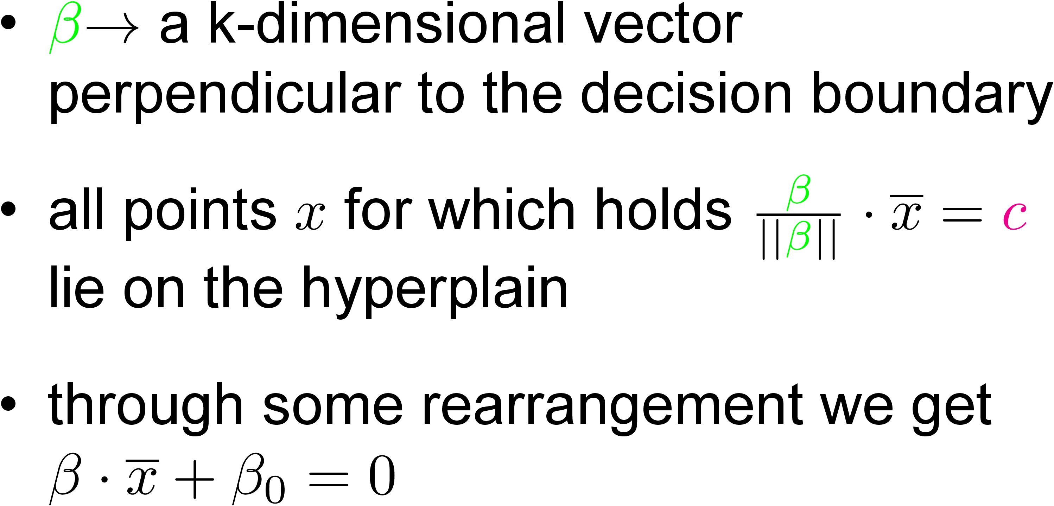
2.1. Hard Margin: Decision Boundary

Slide 5
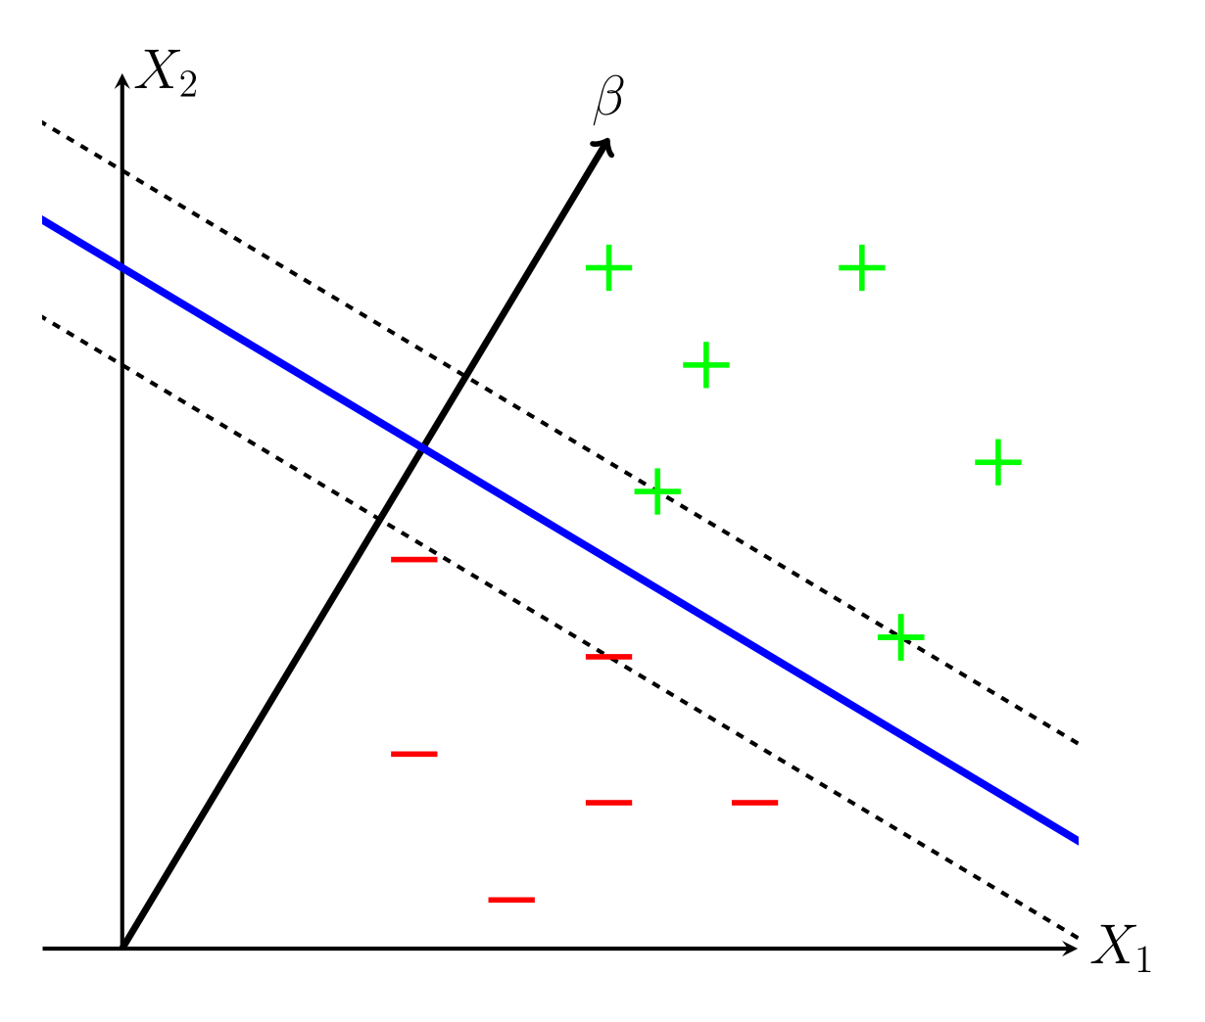
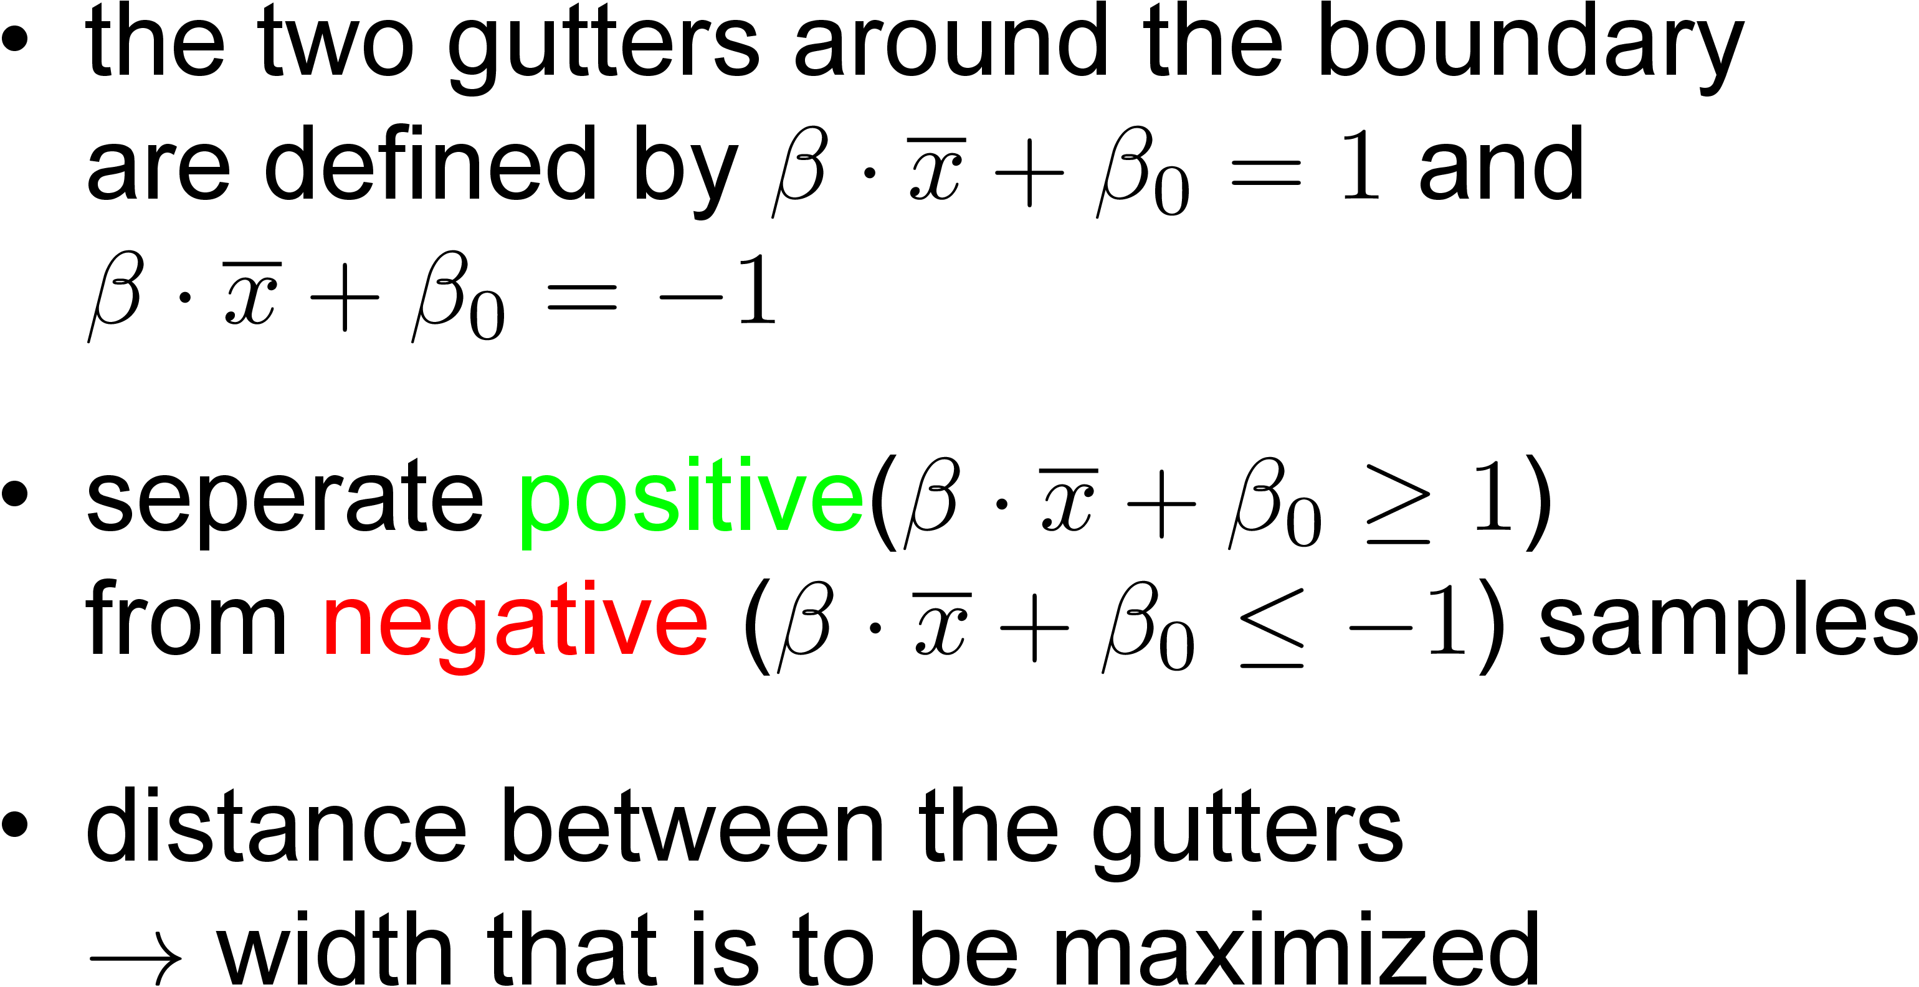
2.1. Hard Margin: Decision Boundary

Slide 6
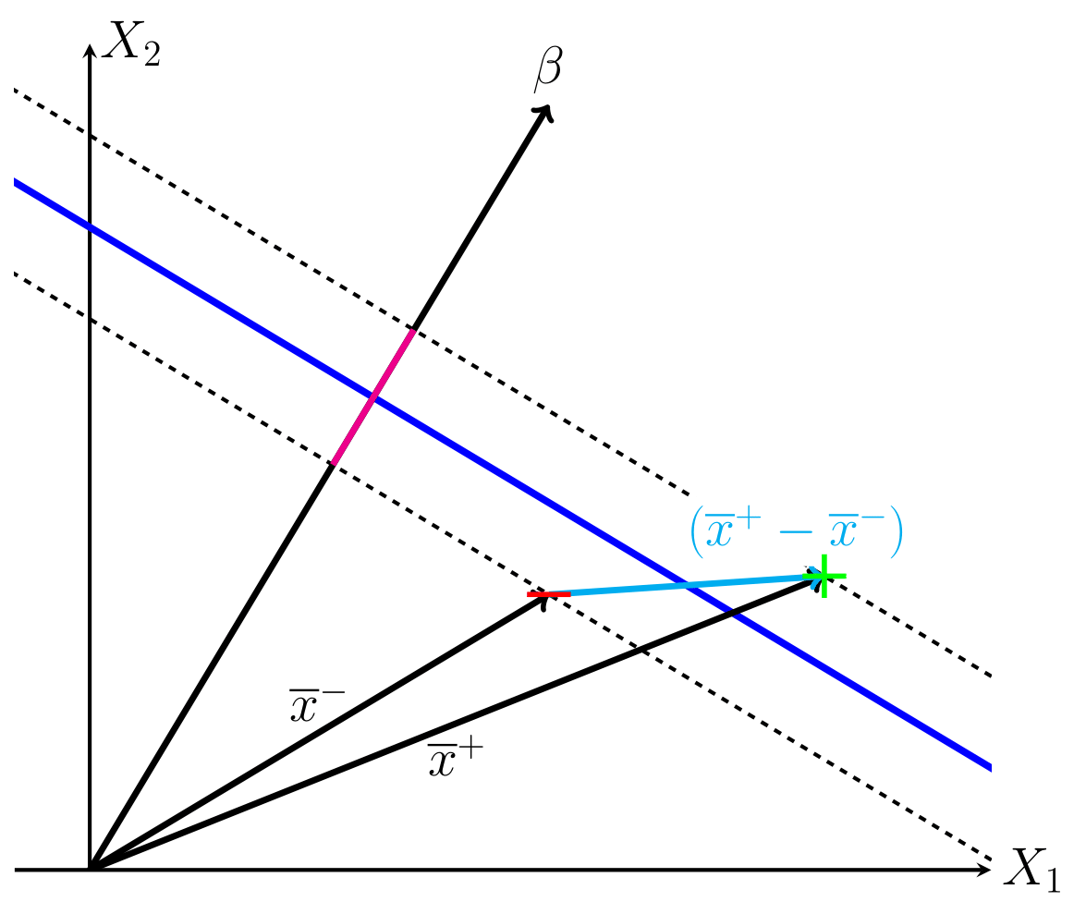
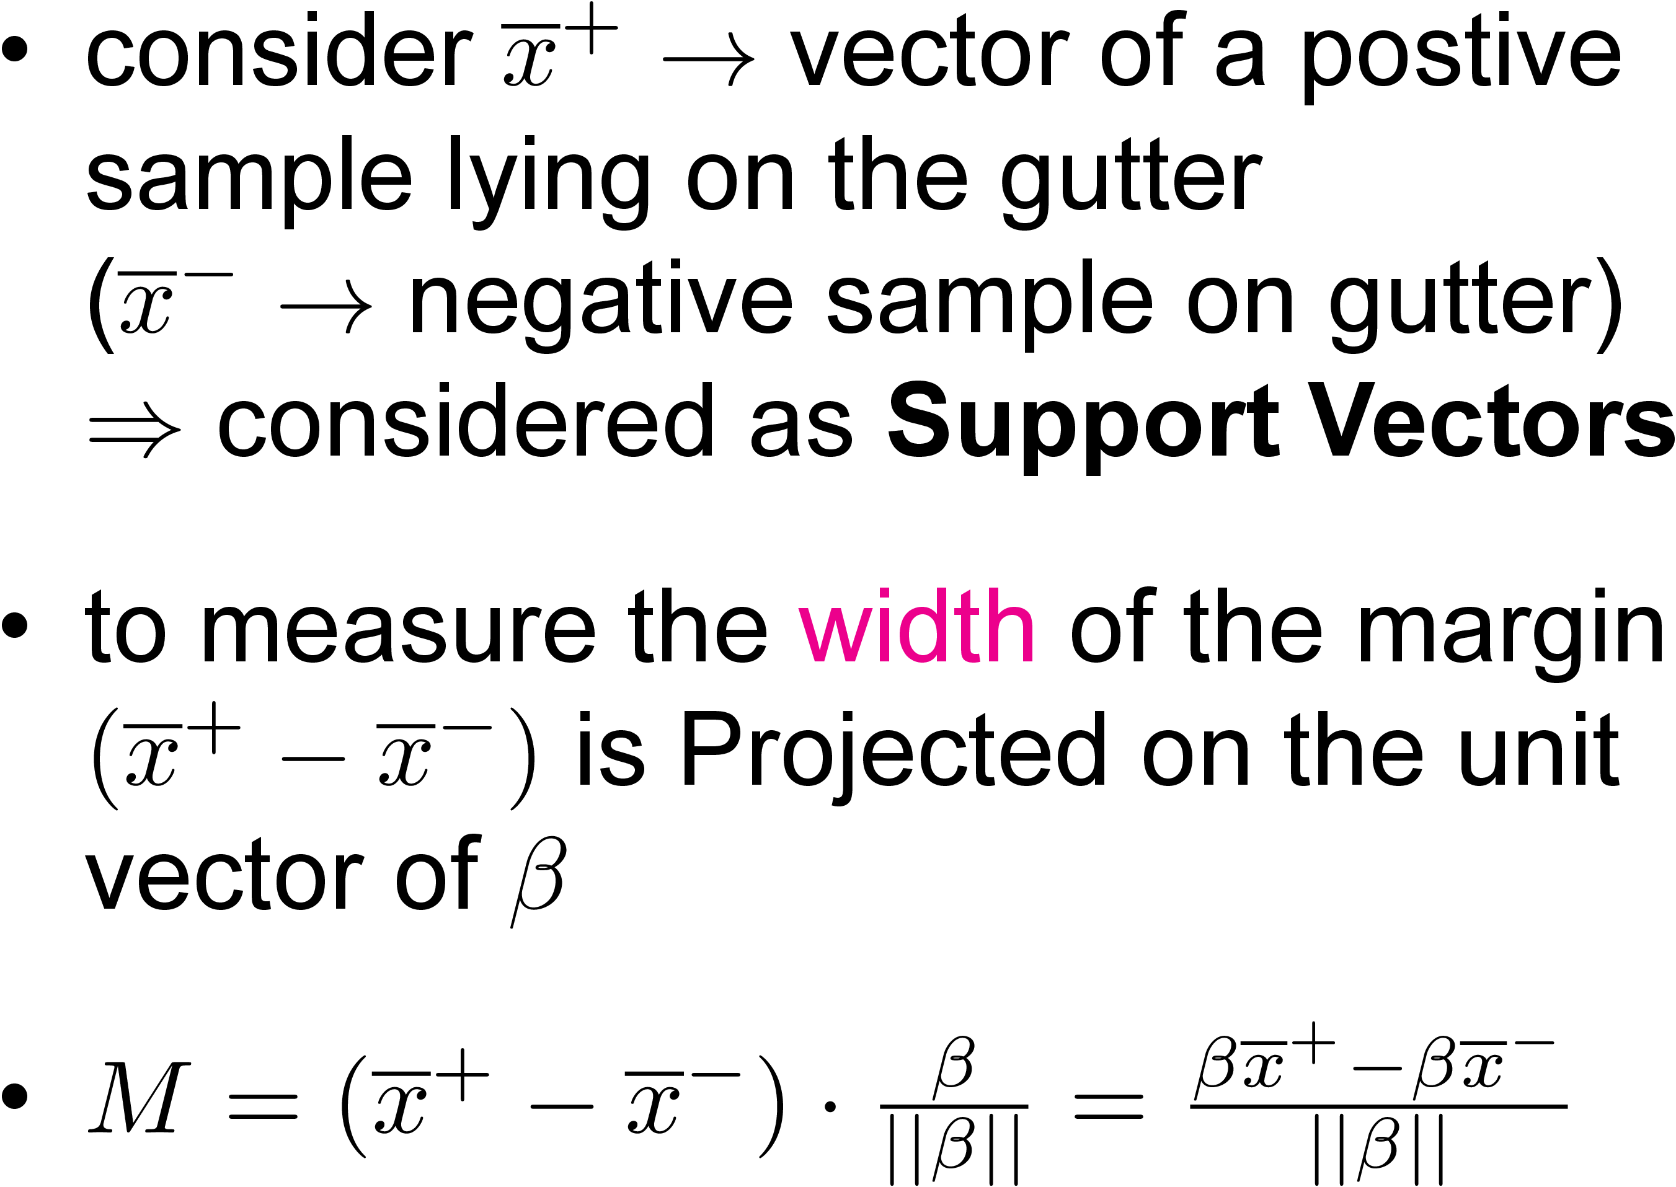
2.1. Hard Margin: maximize Margin Width

Slide 7
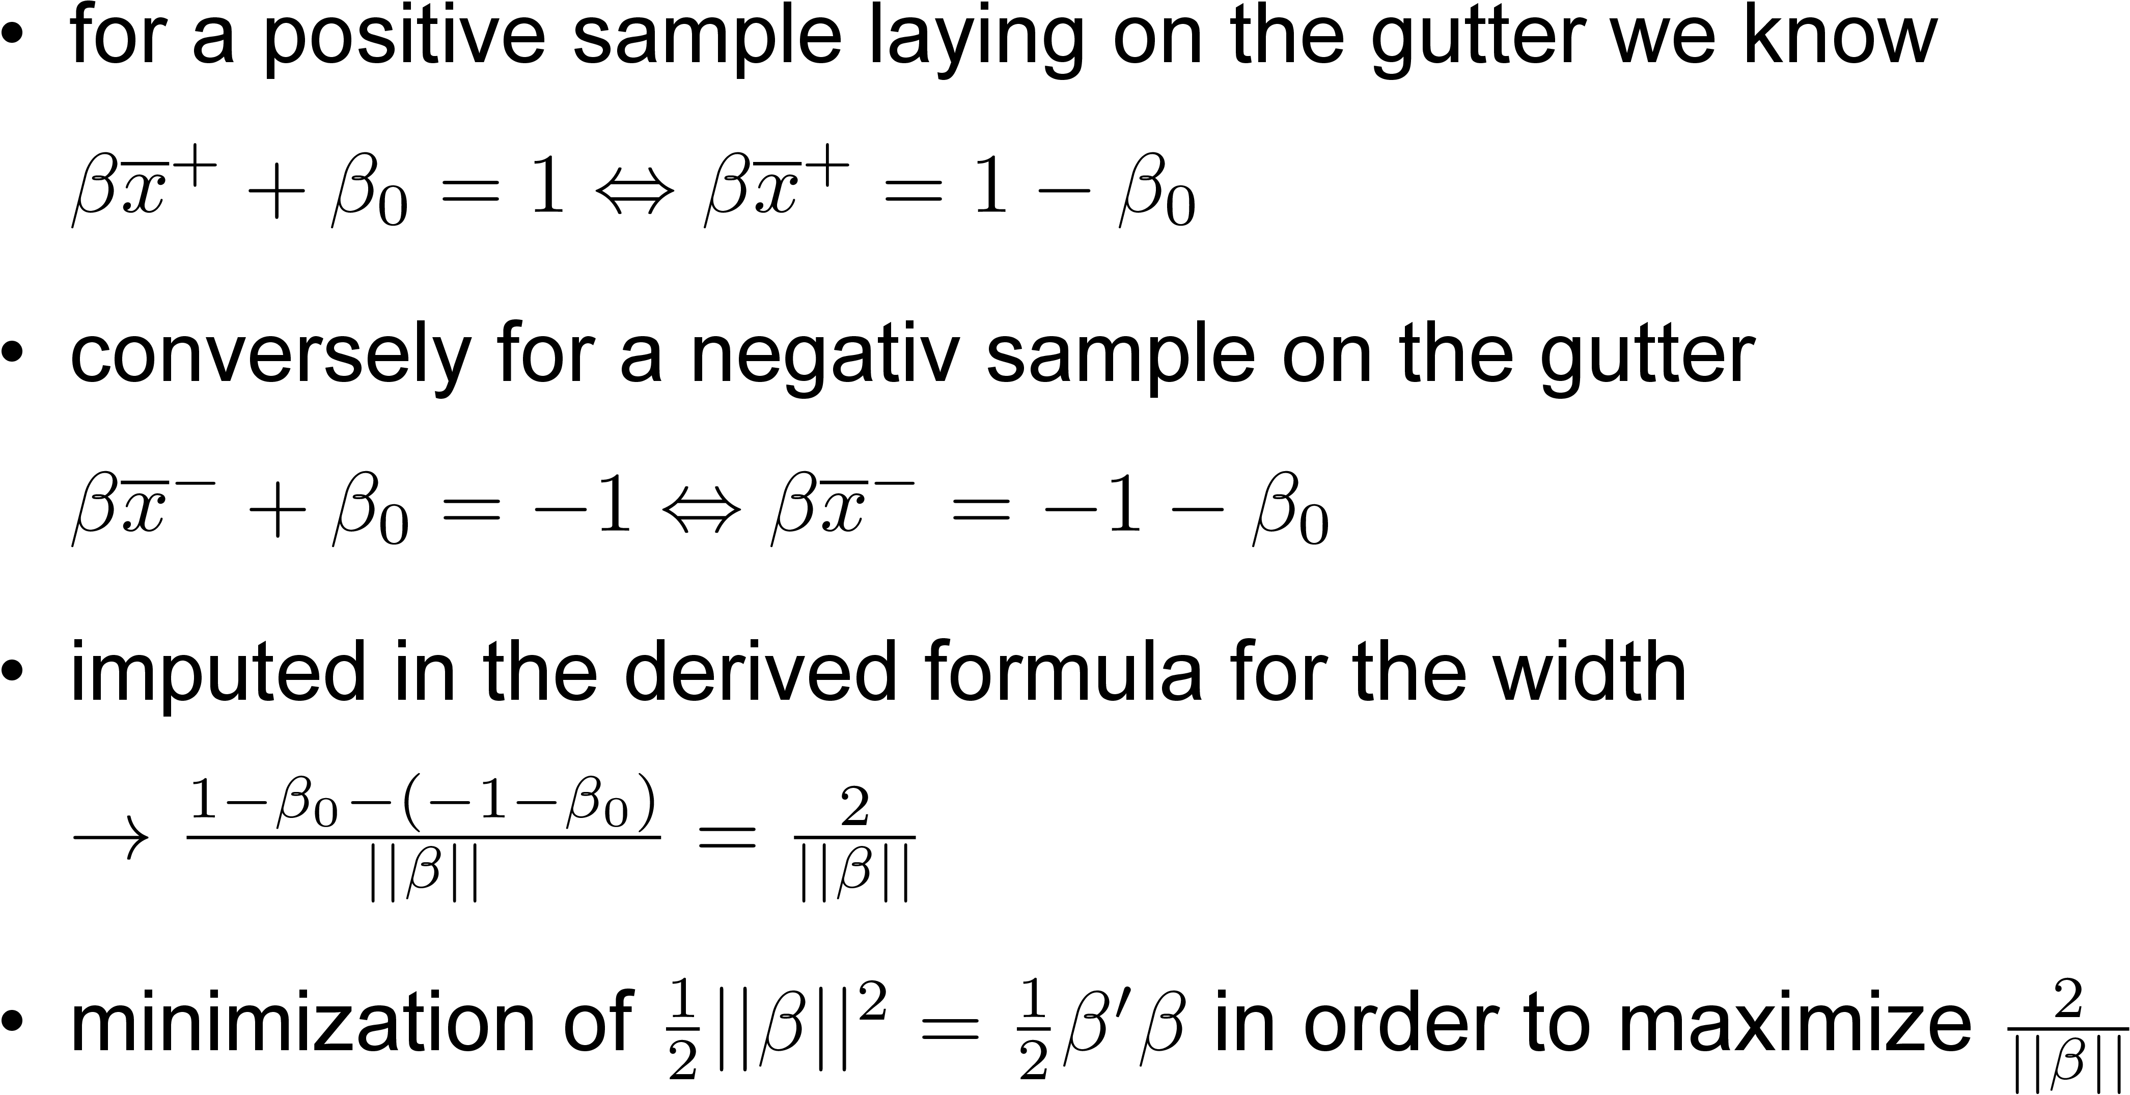
Hard Margin: maximize Margin Width

Slide 8
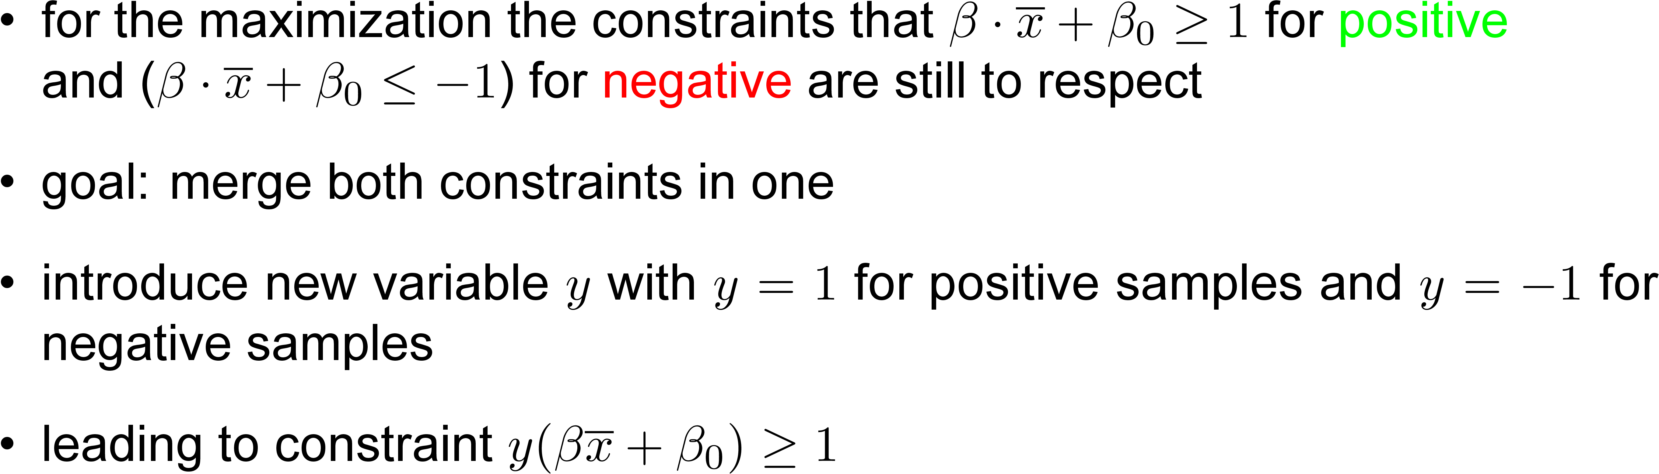
2.1. Hard Margin: maximize Margin Width

Slide 9
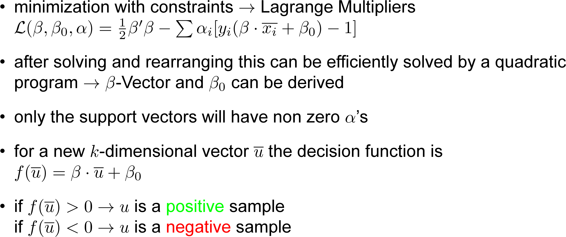
2.1. Hard Margin: maximize Margin Width

Slide 10
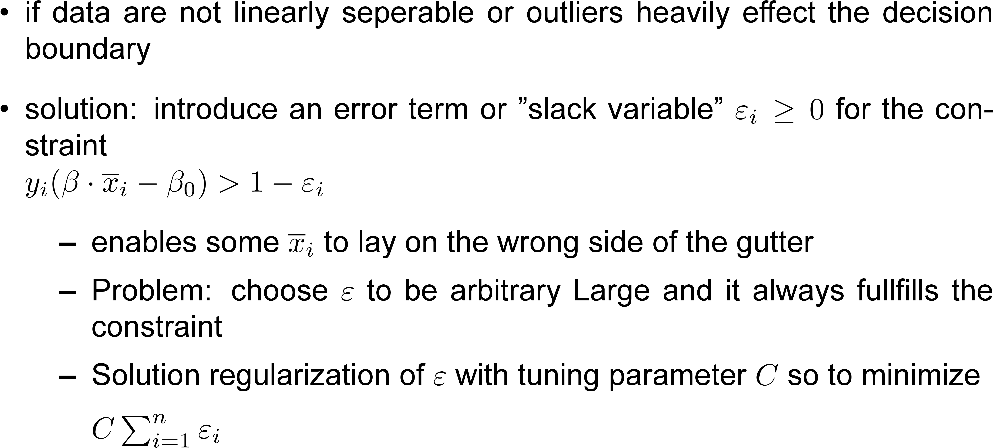
2.2. Soft Margin

Slide 11
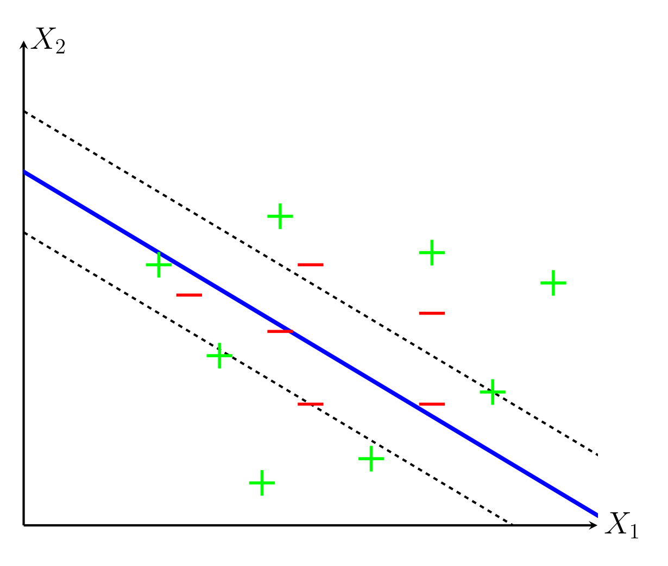
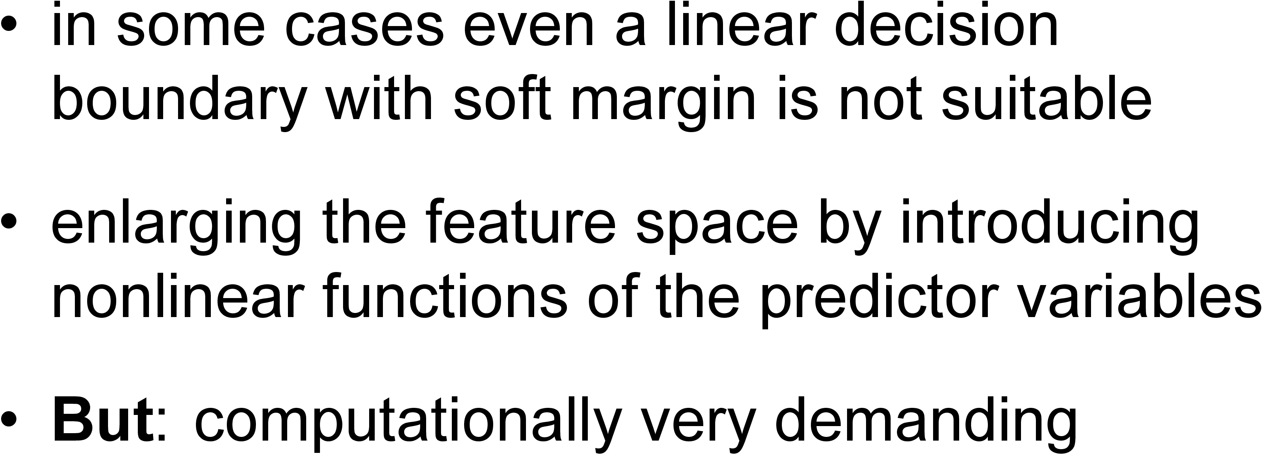
2.3. Kernel trick

Slide 12
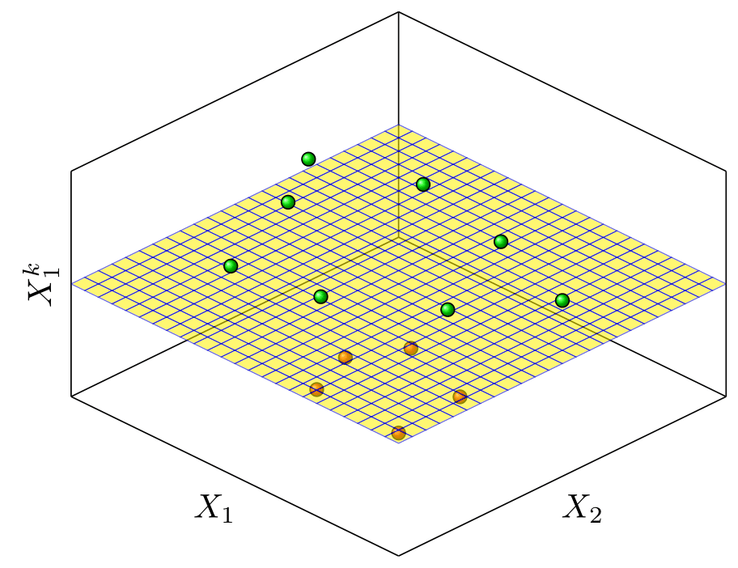
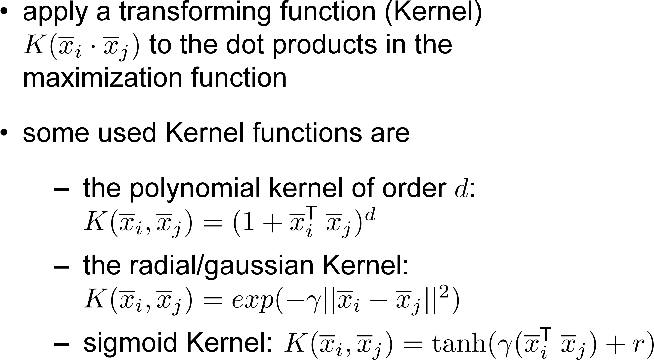
2.3. Kernel trick

Slide 13
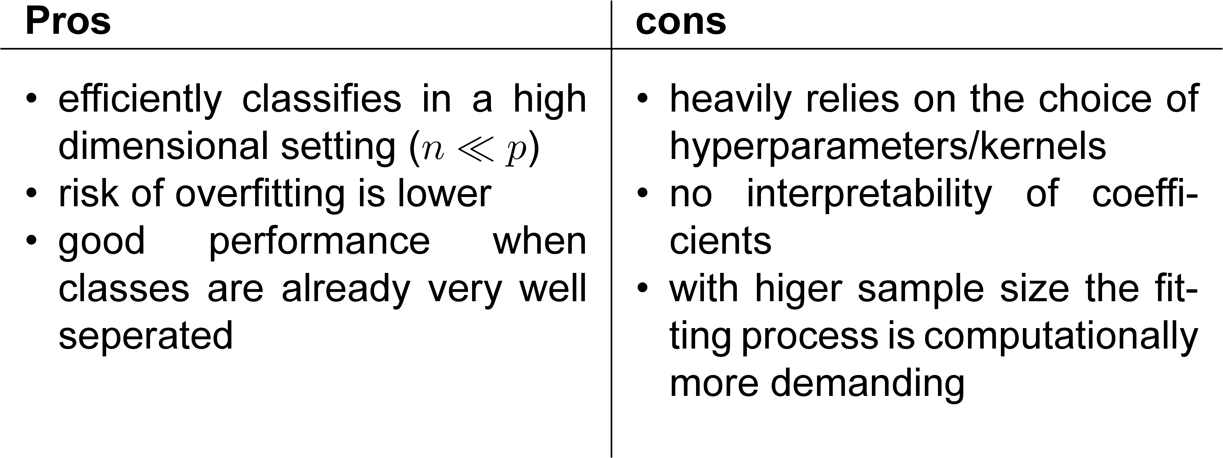
3. Pros and Cons

Slide 14
4. Performance Evaluation
Goal: evaluate the performance of different SVM models in different data Situations
Comparison with other classification Methods
Simulate data with varying decision boundaries and dimensions
Measure Accuracy and also benchmarking results

Slide 15
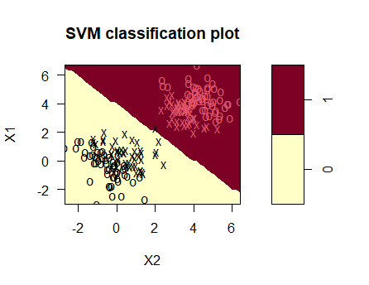
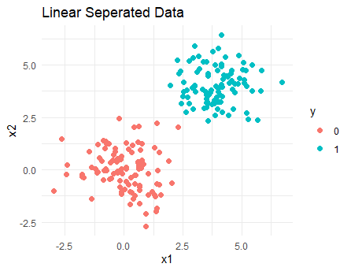
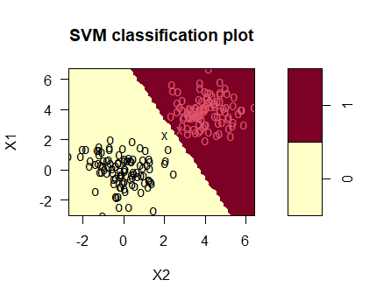
5. Current Status
Linear Kernel (accuracy: 1)
Radial Kernel (accuracy: 0.99)

Slide 16
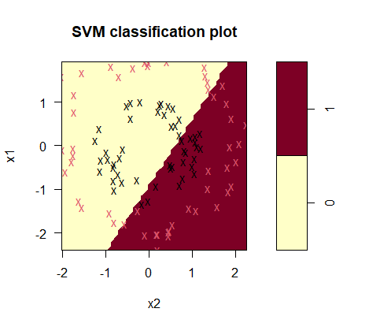
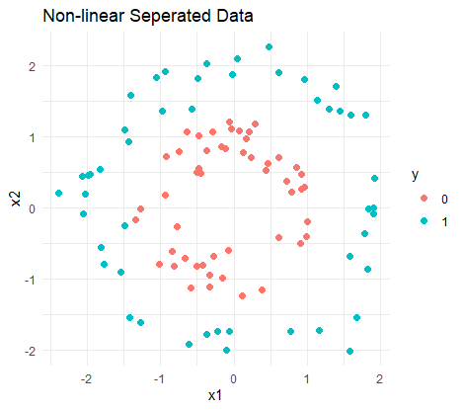
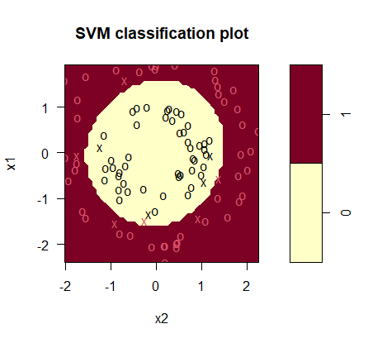
5. Current Status
Linear Kernel (accuracy: 0.46)
Radial Kernel (accuracy: 0.99)

Slide 17
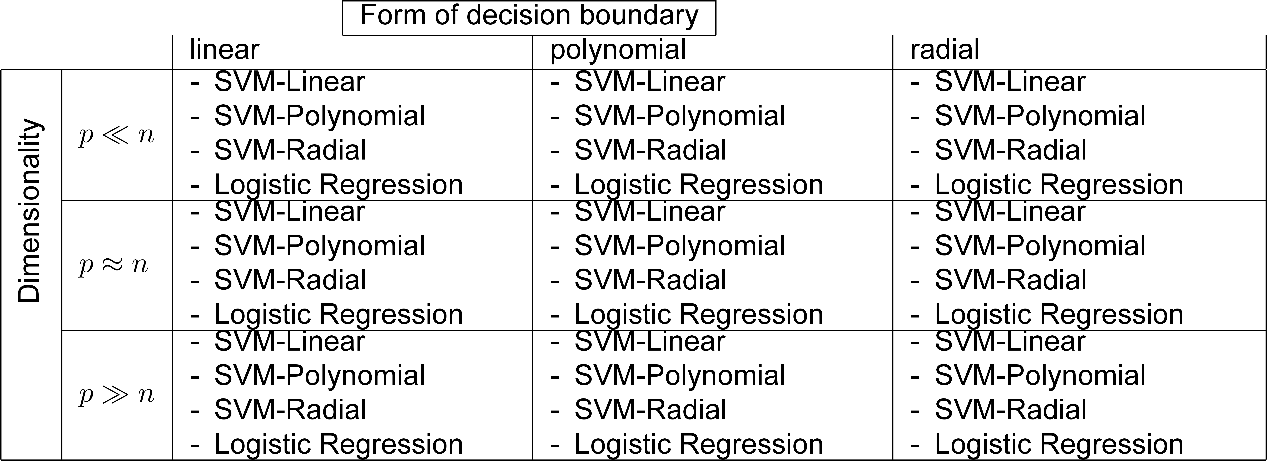
6. What comes next?
Find reliable hypothesis/sources for the performance in different data situations

Slide 18
6. Sources
Boser, B. E., Guyon, I. M., & Vapnik, V. N. (1992). A training algorithm for optimal margin classifiers. Proceedings of the Fifth Annual Workshop on Computational Learning Theory, 144–152. https://doi.org/10.1145/130385.130401
Cortes, C., & Vapnik, V. (1995). Support-vector networks. Machine Learning, 20(3), 273–297.https://doi.org/10.1007/BF00994018
James, G., Witten, D., Hastie, T., & Tibshirani, R. (2021). An Introduction to Statistical Learning: With Applications in R. Springer US. https://doi.org/10.1007/978-1-0716-1418-1

Slide 19
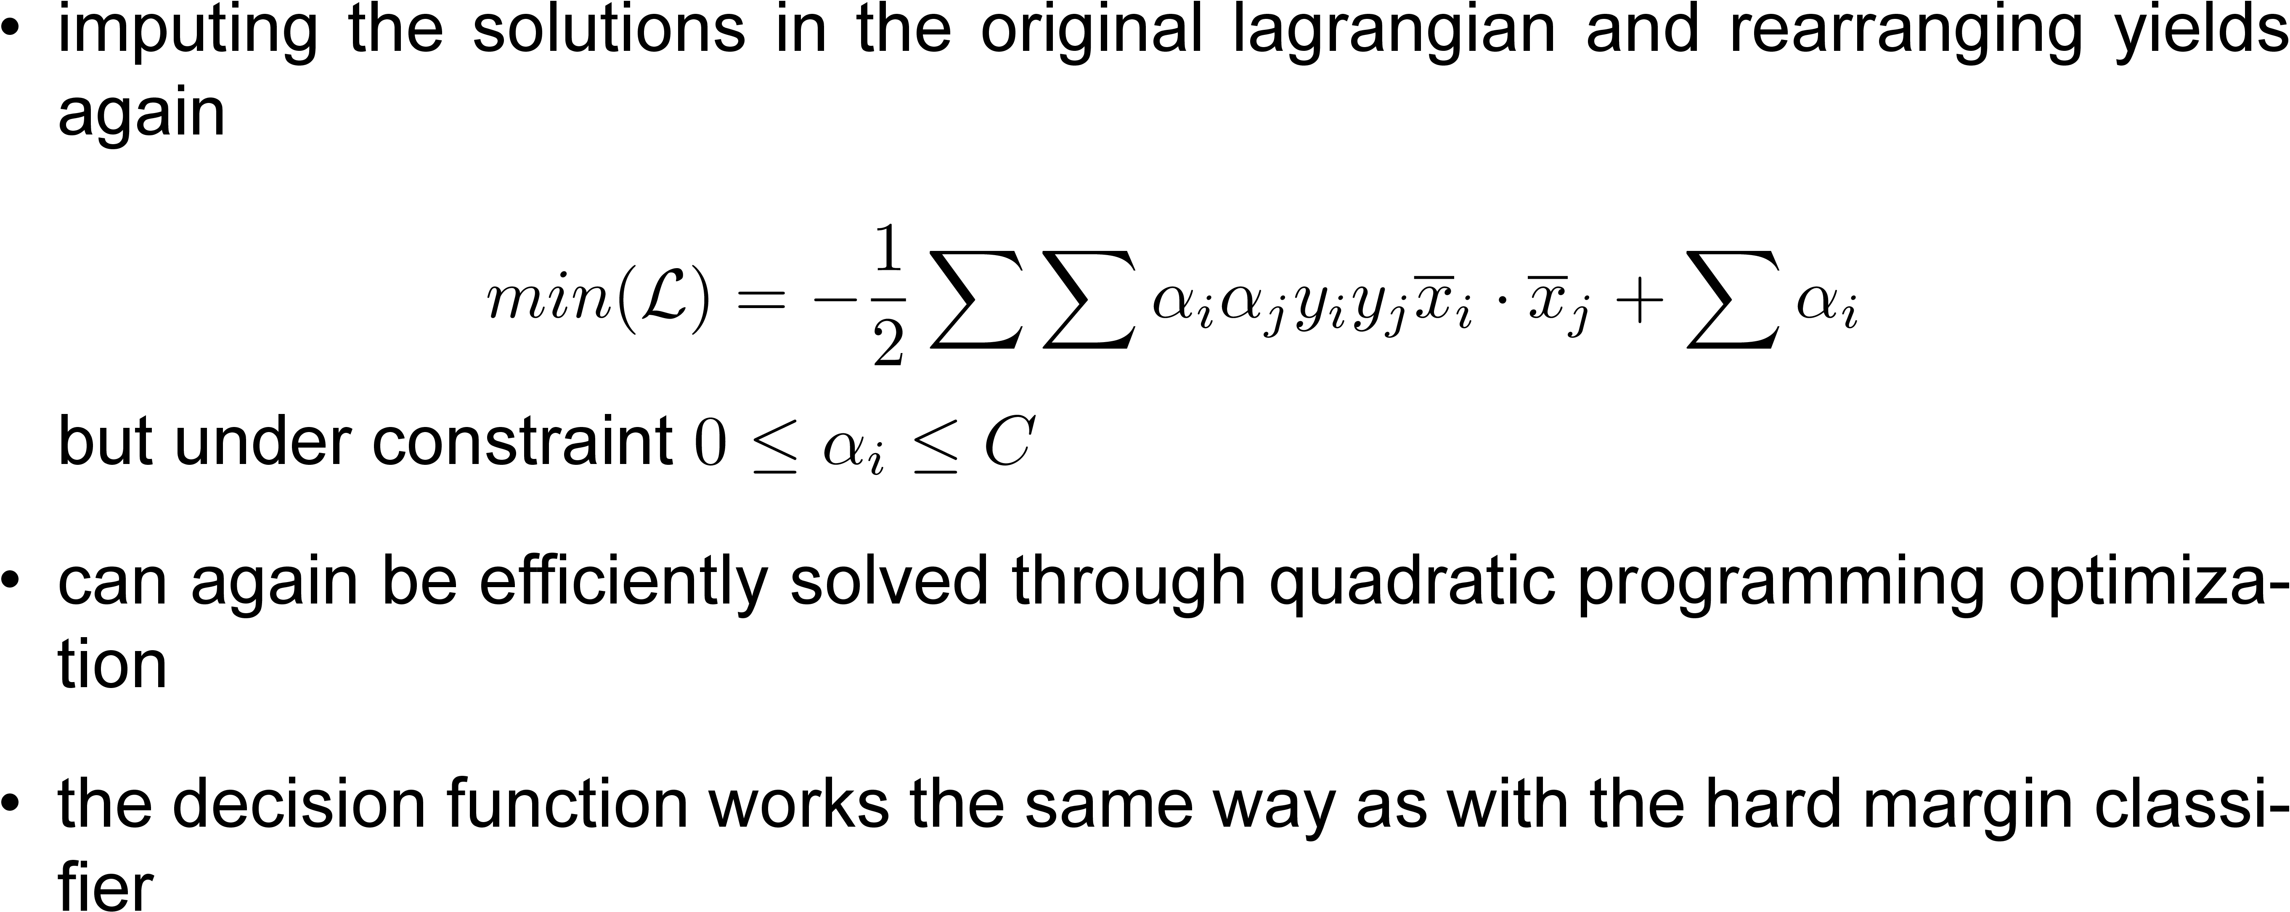
How it works: Soft Margin

Slide 20
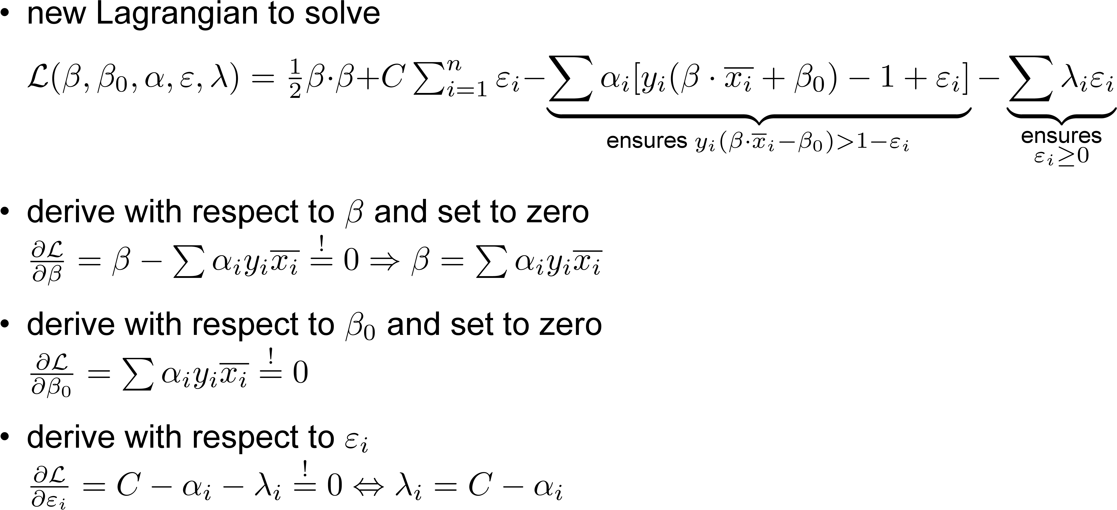
How it works: Soft Margin

Slide 21
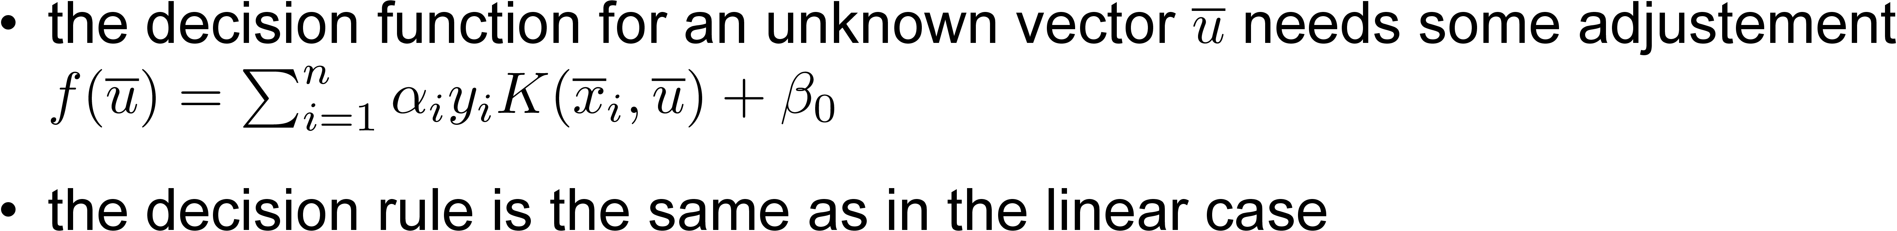
How it works: use of Kernels

Slide 22
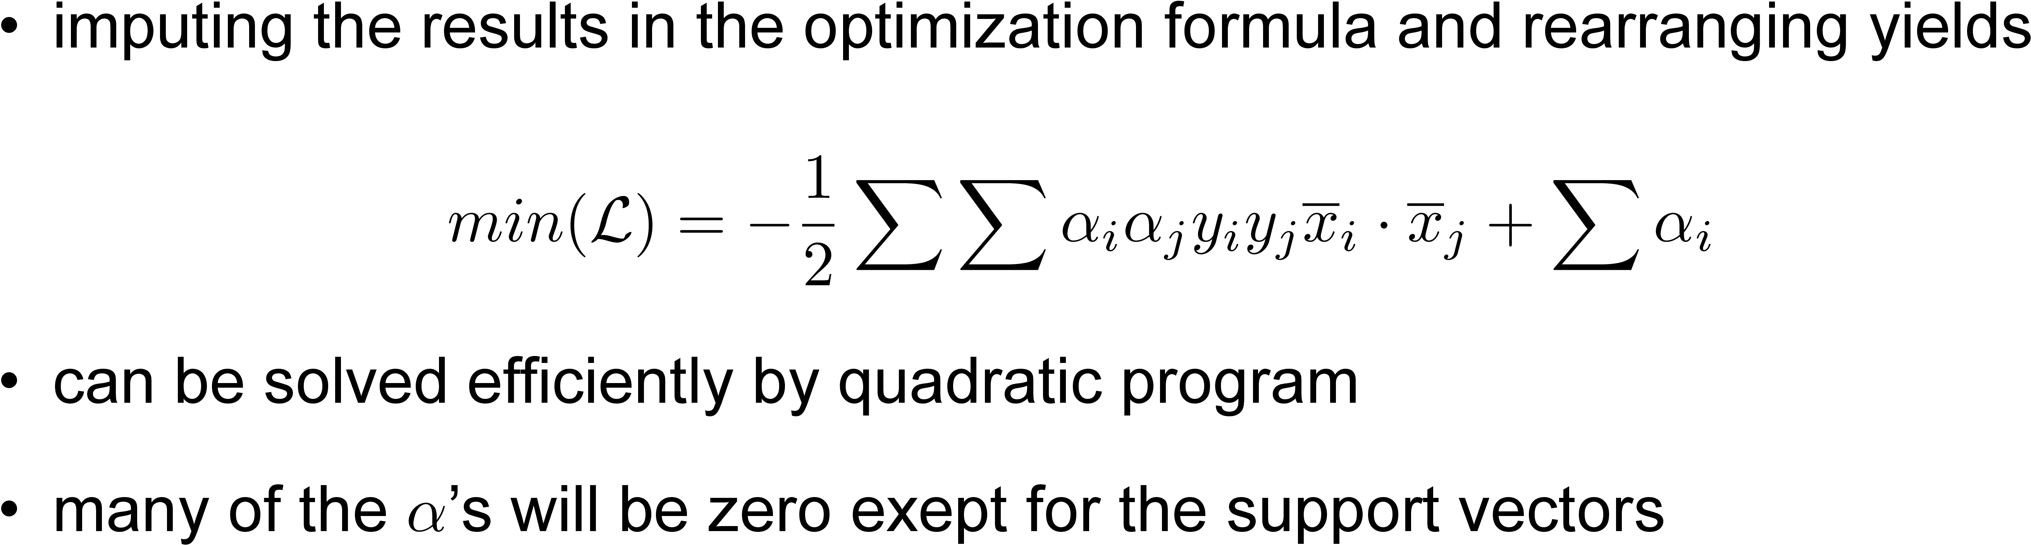
How it works: Maximization Process

Slide 23
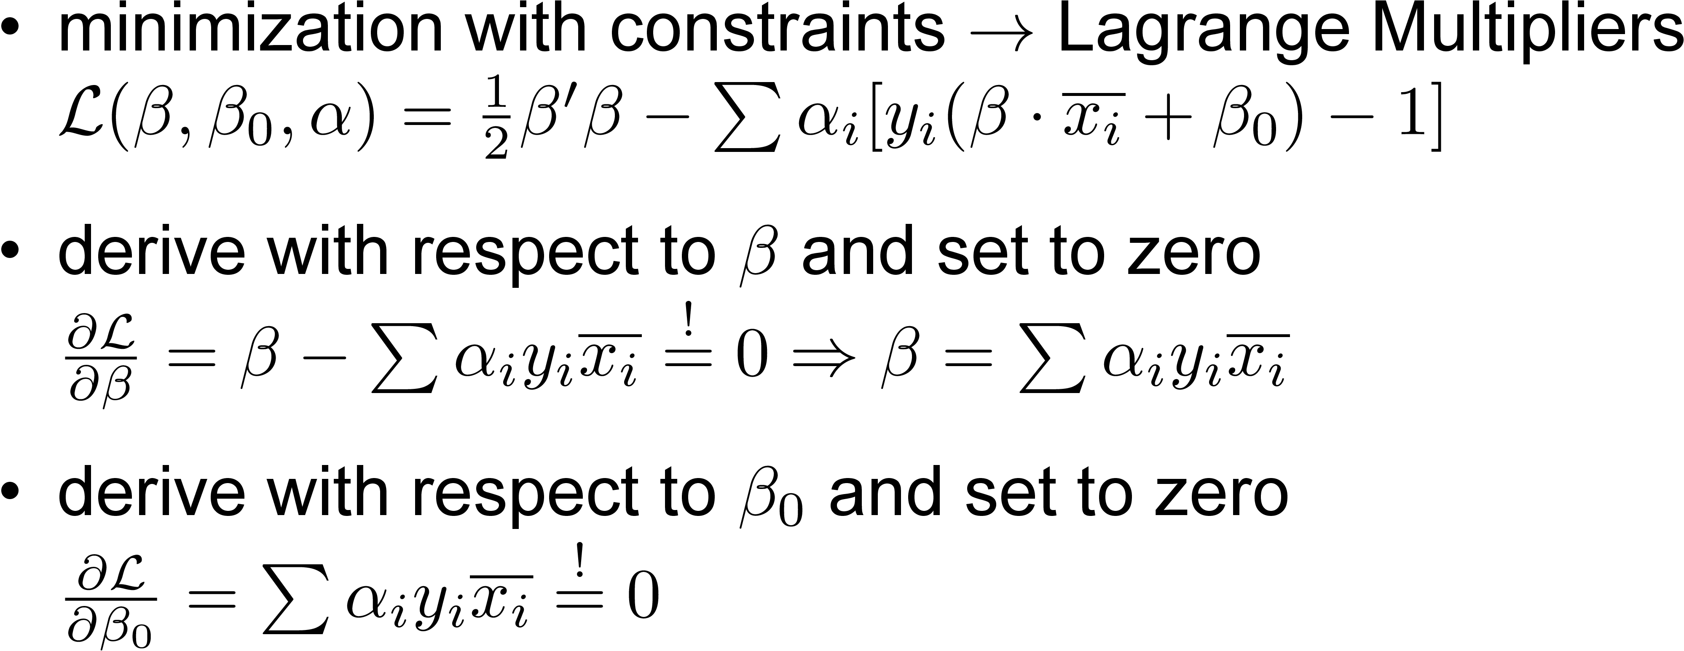
How it works: Maximization Process

Slide 24
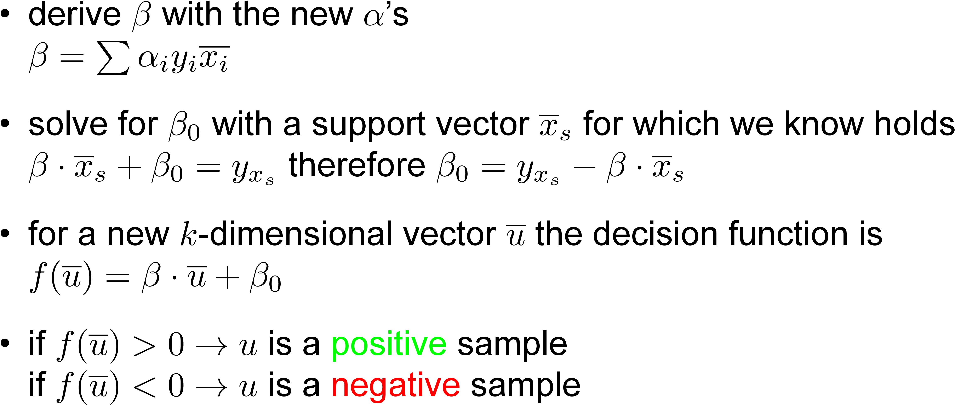
2.1. Hard Margin: Decision Rule

Slide 25
1. History of Support Vector Machine
Early ideas of a seperating Hyperplane 1936 (R. Fisher)
First SVM algorithm in 1964 (V. Vapnik, A. Chervonenkis)
Use of kernel trick for nonlinear classifiers in 1992 (B. Boser, I. Guyon, V. Vapnik)
Introduction of „soft margin“ in 1995 (C. Cortes, V. Vapnik)

